Slide 1


Exploratory Science
Welcome to
Open House

Slide 2
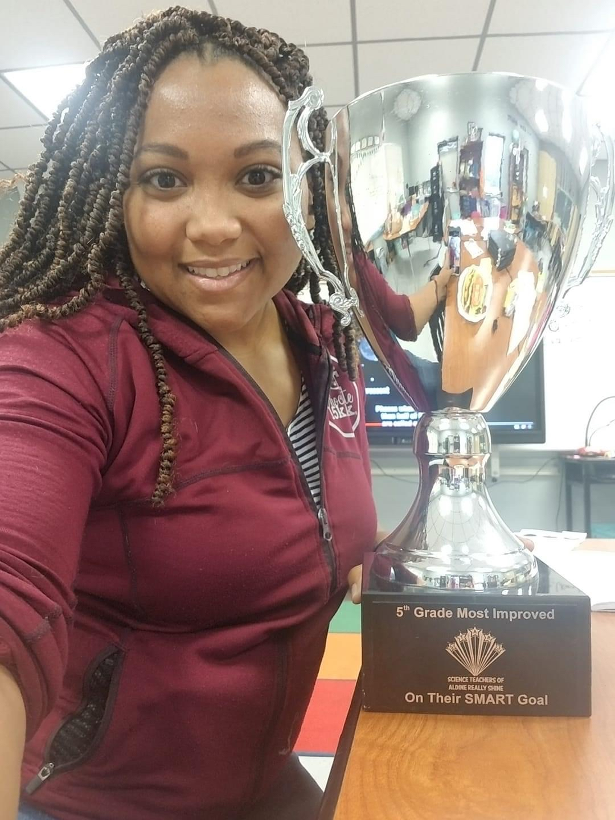
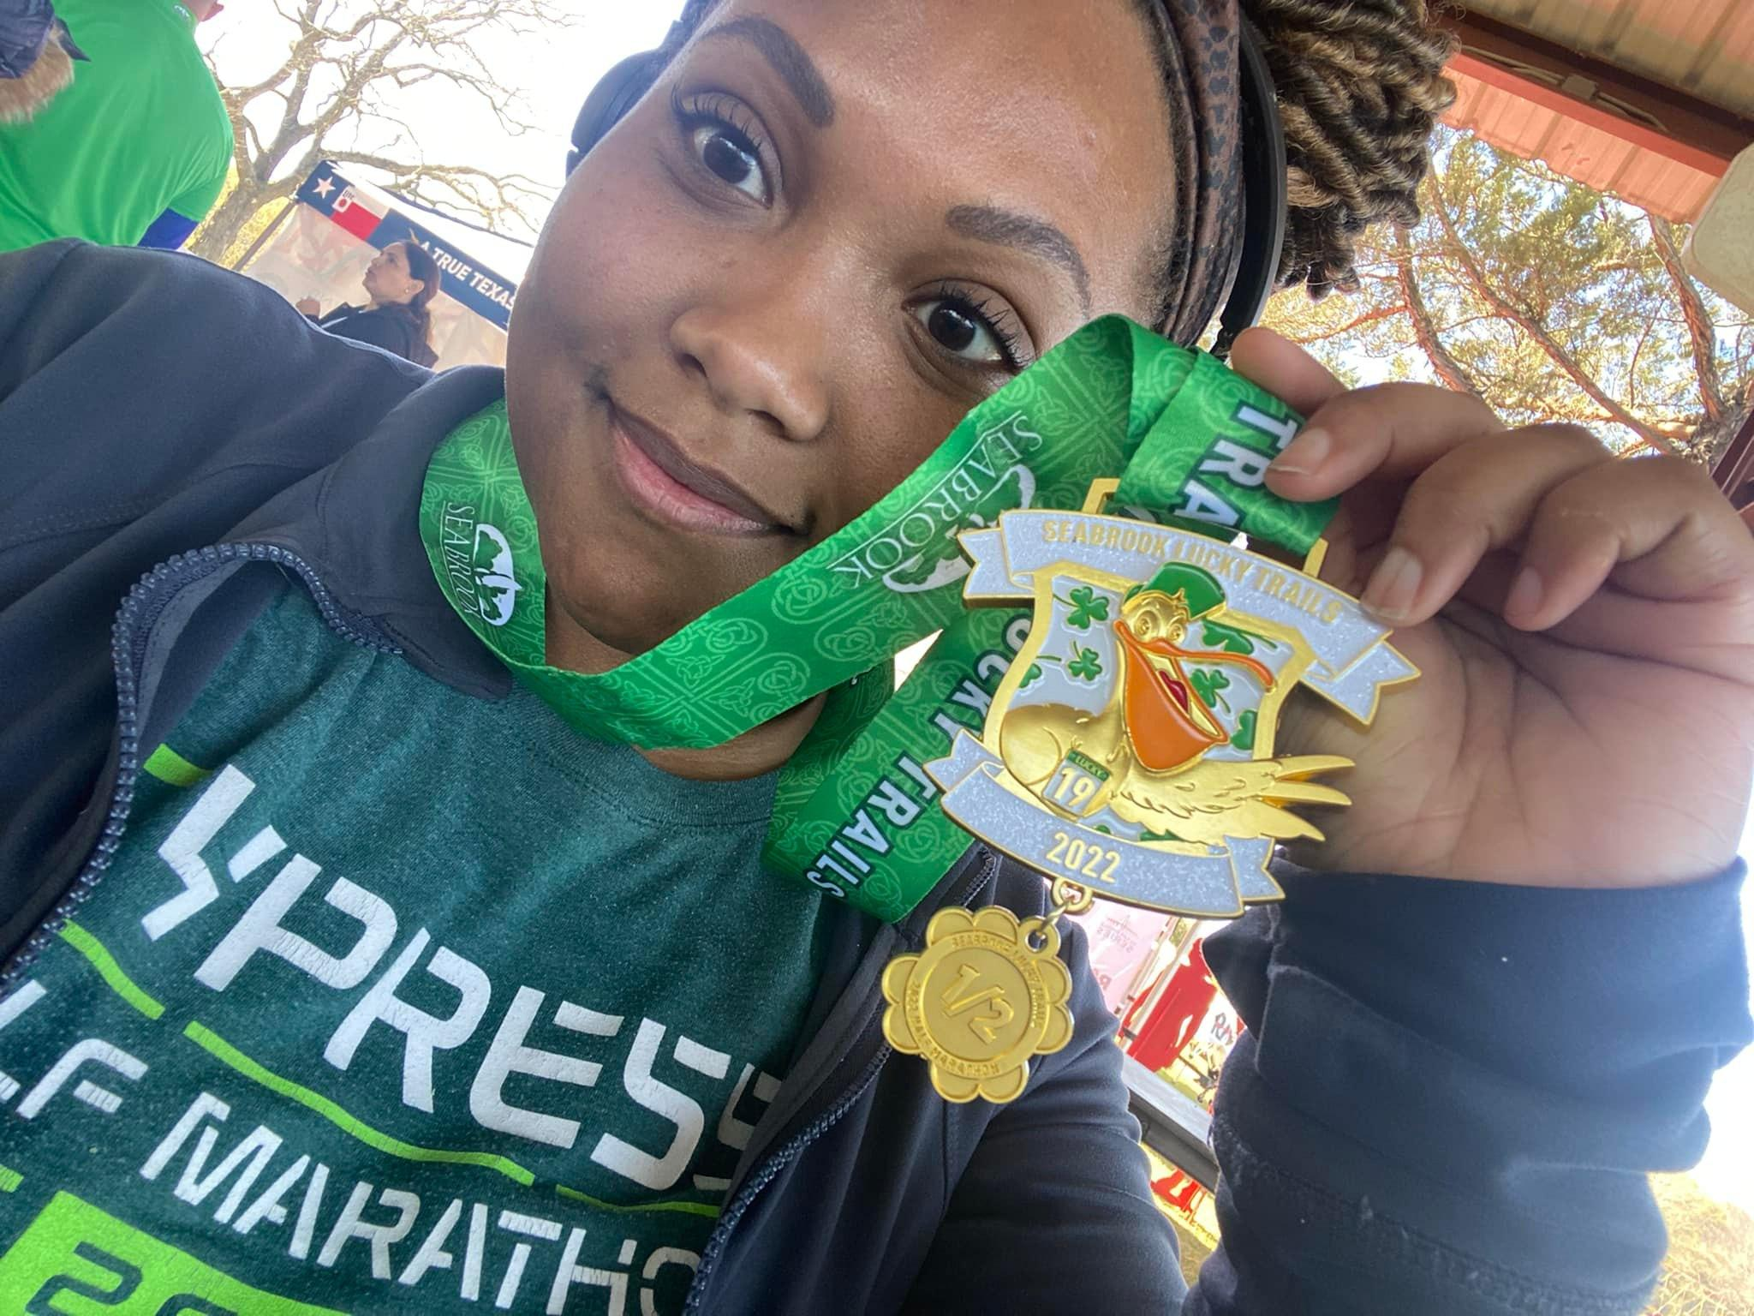
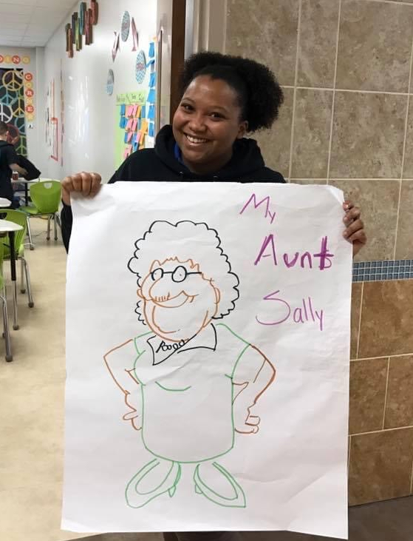
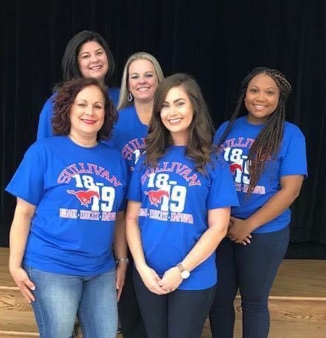
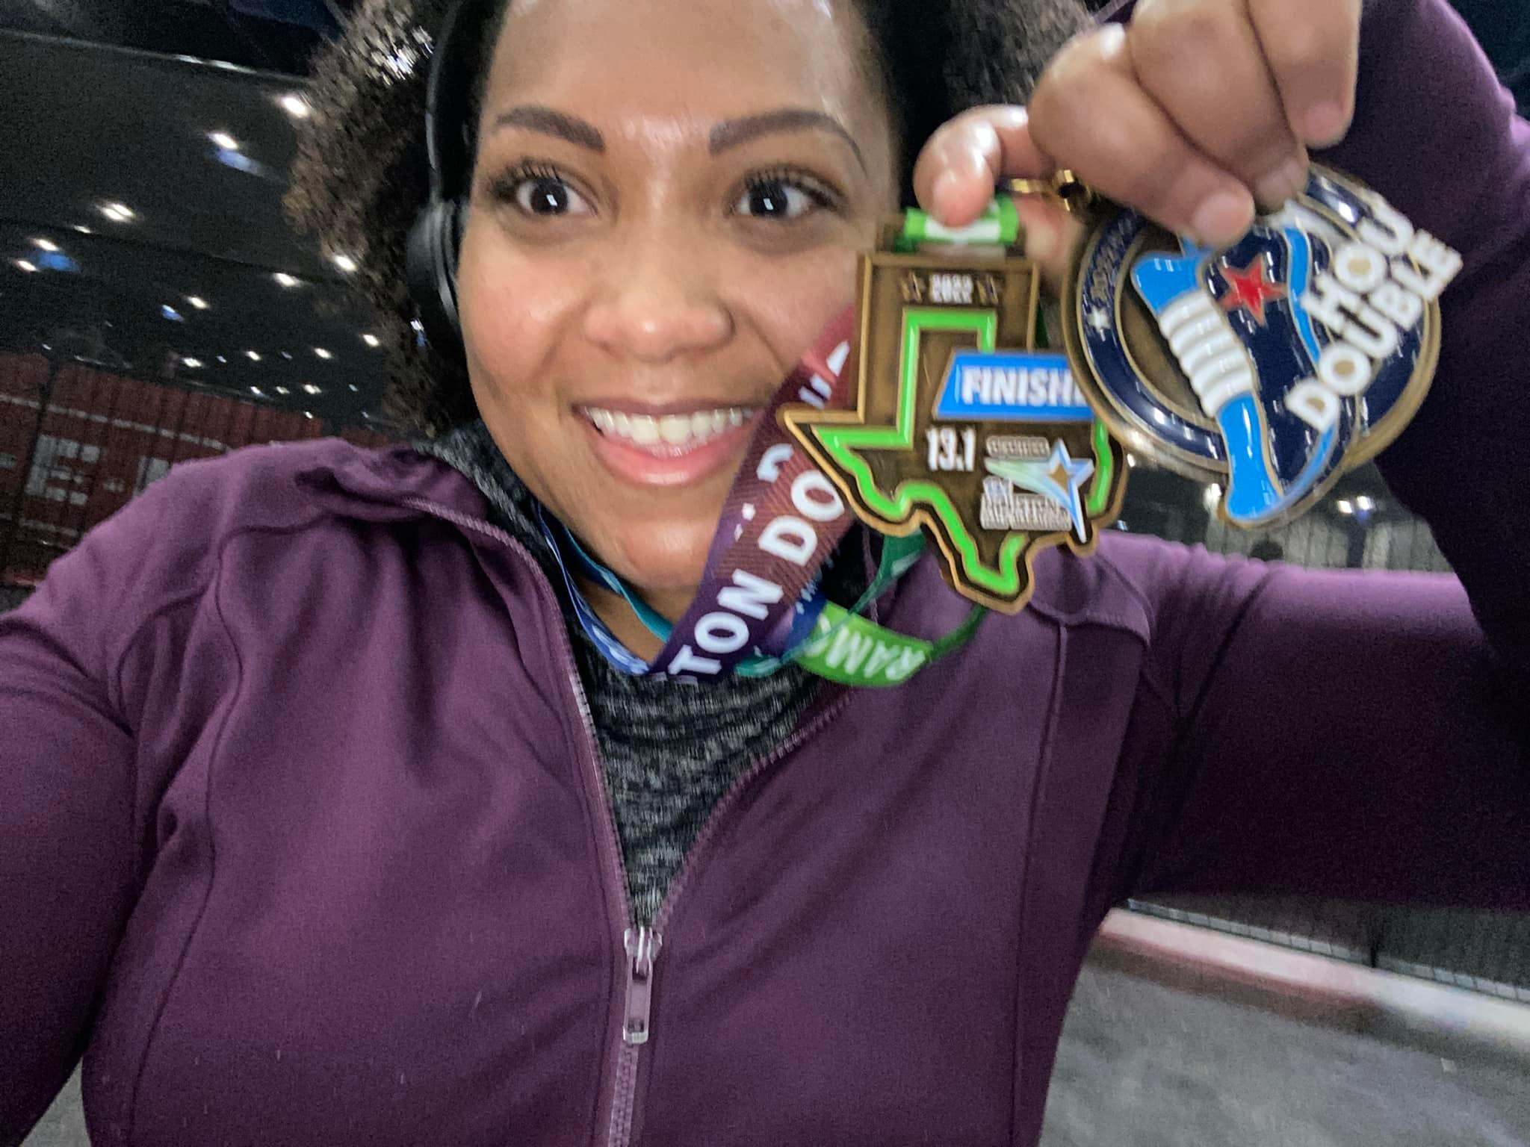
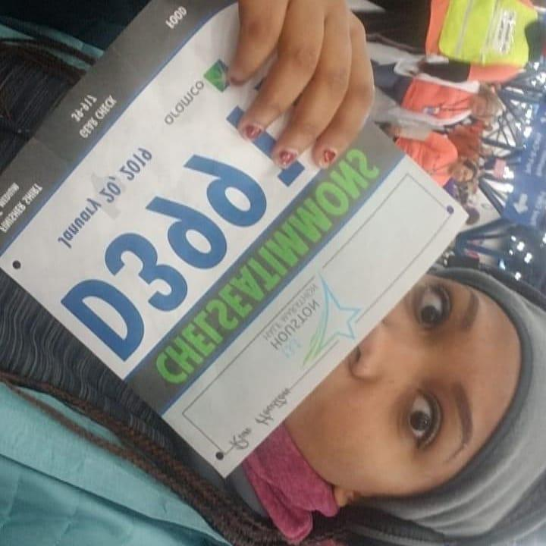
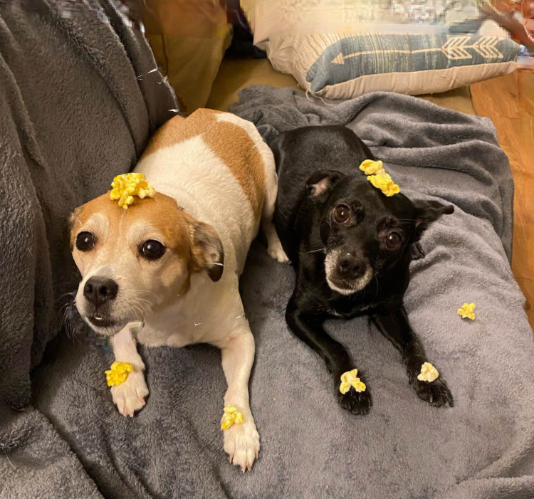
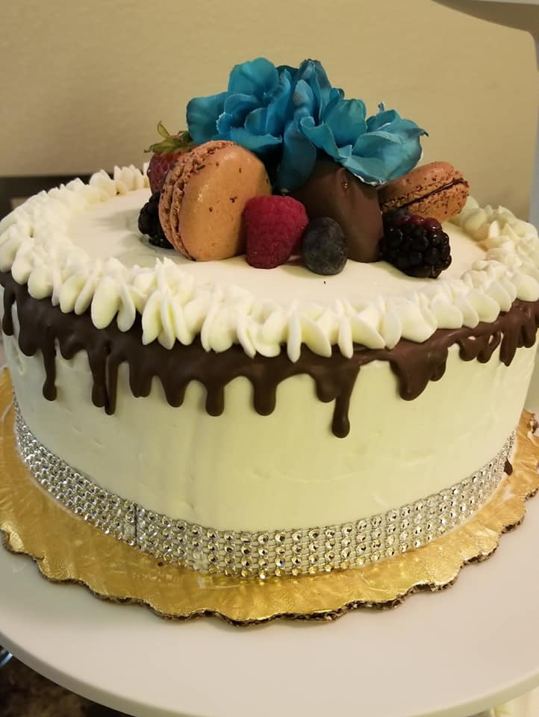
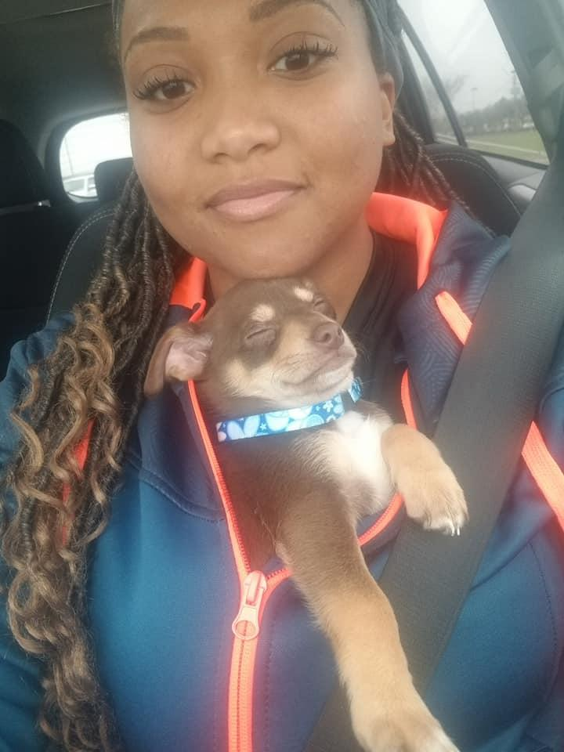
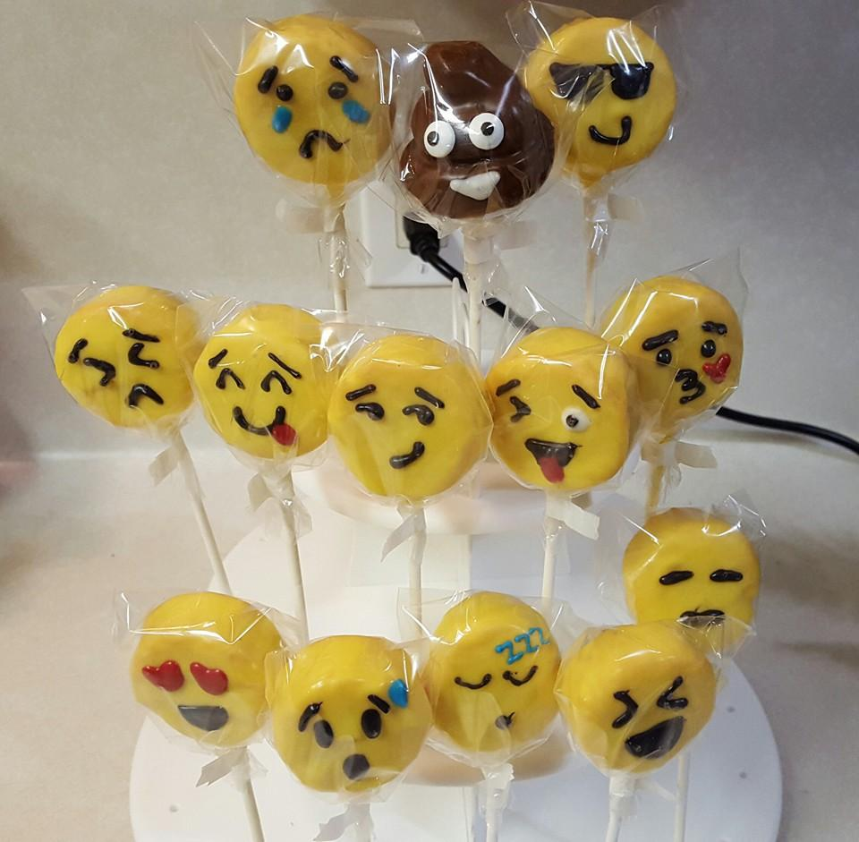
About Ms. Timmons
Eighth year in Education
First year at T.H. Rogers
Avid baker
Runner
Animal Lover

Slide 3
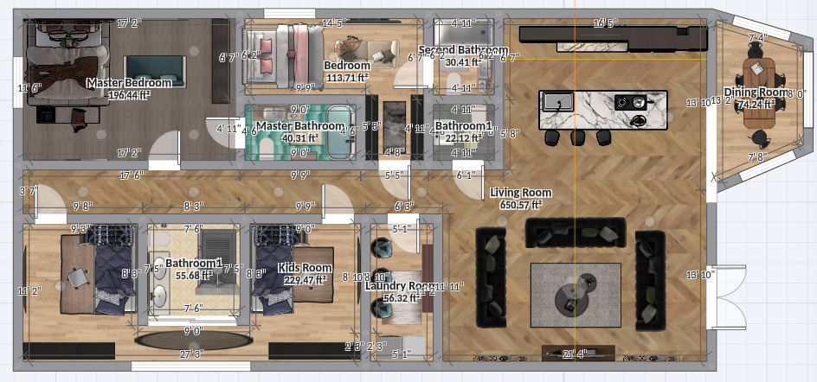
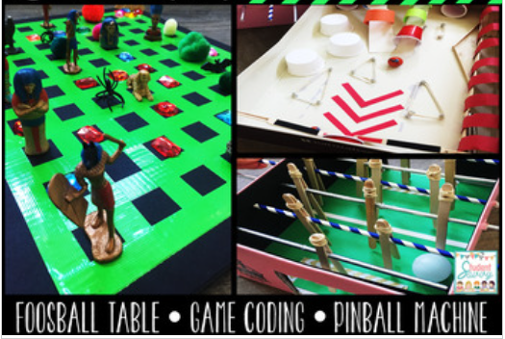
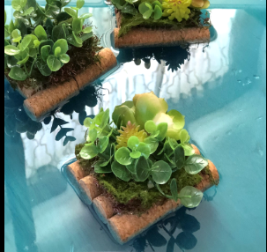
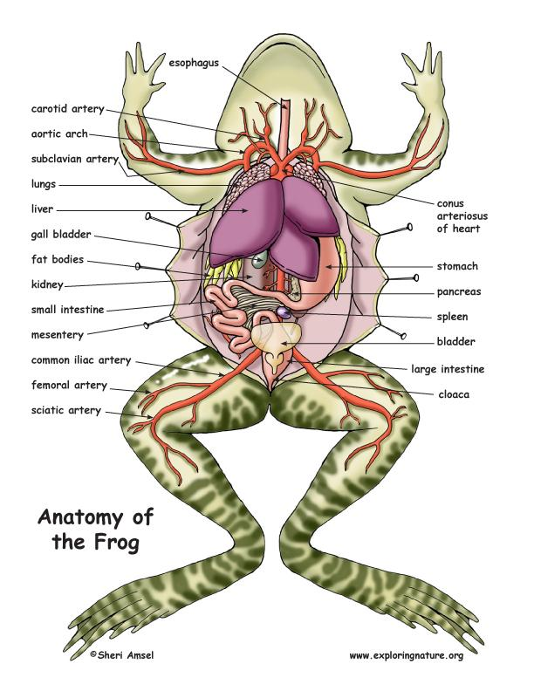
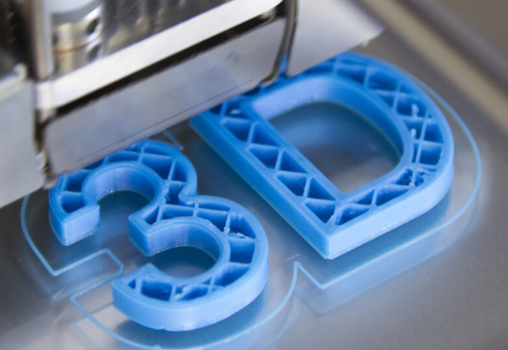
This year i n Class
Architecture
Life Science
Botany
STEAM in History
3D Printing
Laser Cutting
Research Projects
Alternative Energy
Engineering Projects

Slide 4
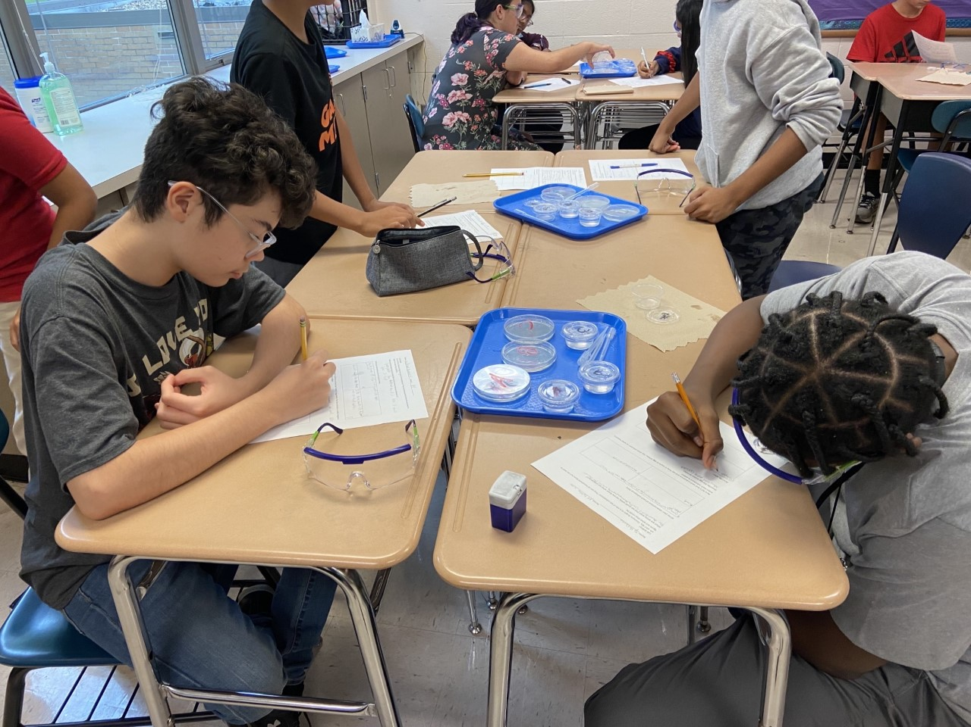
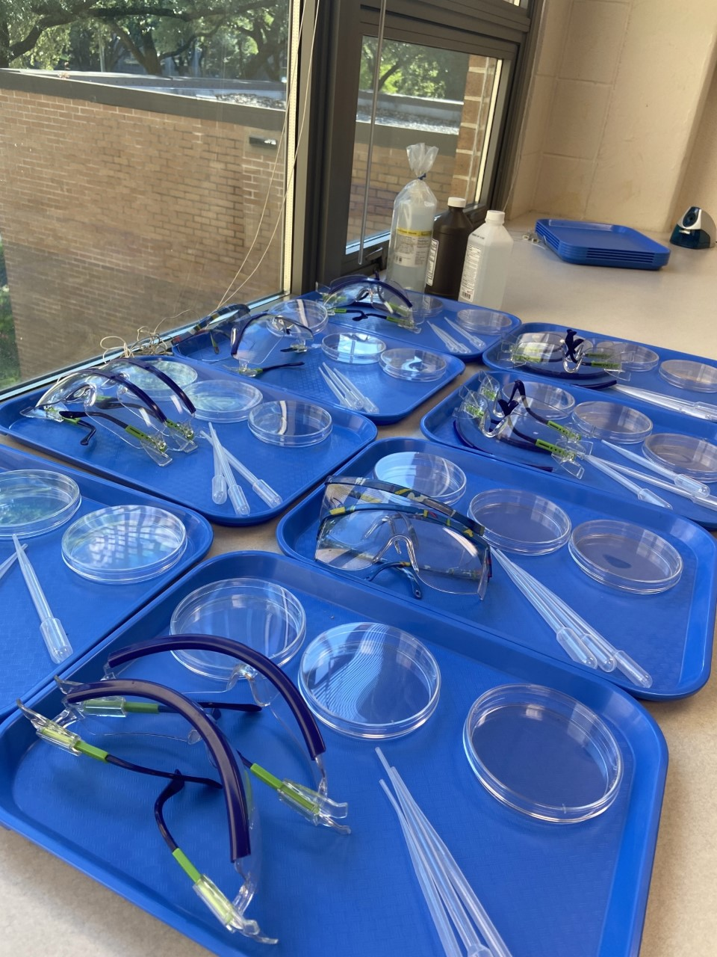
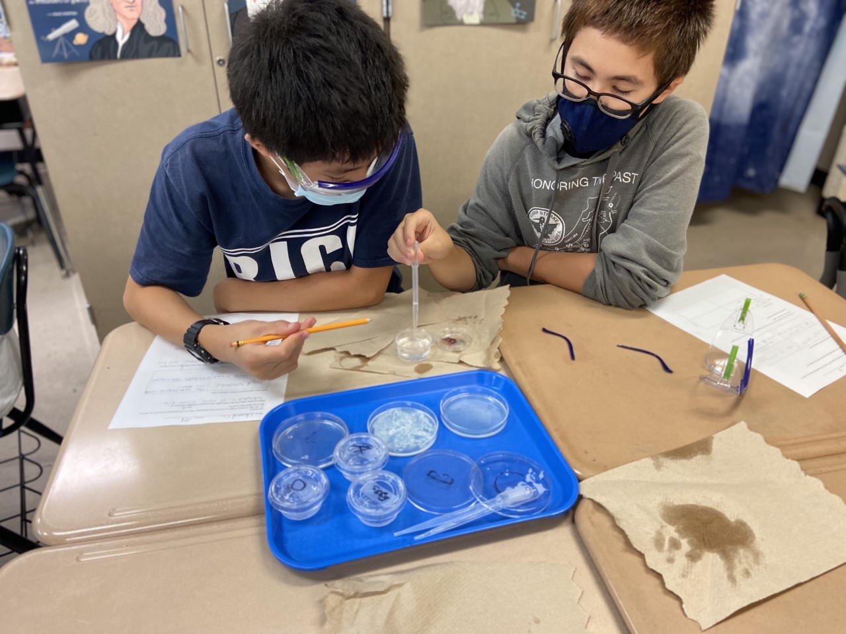
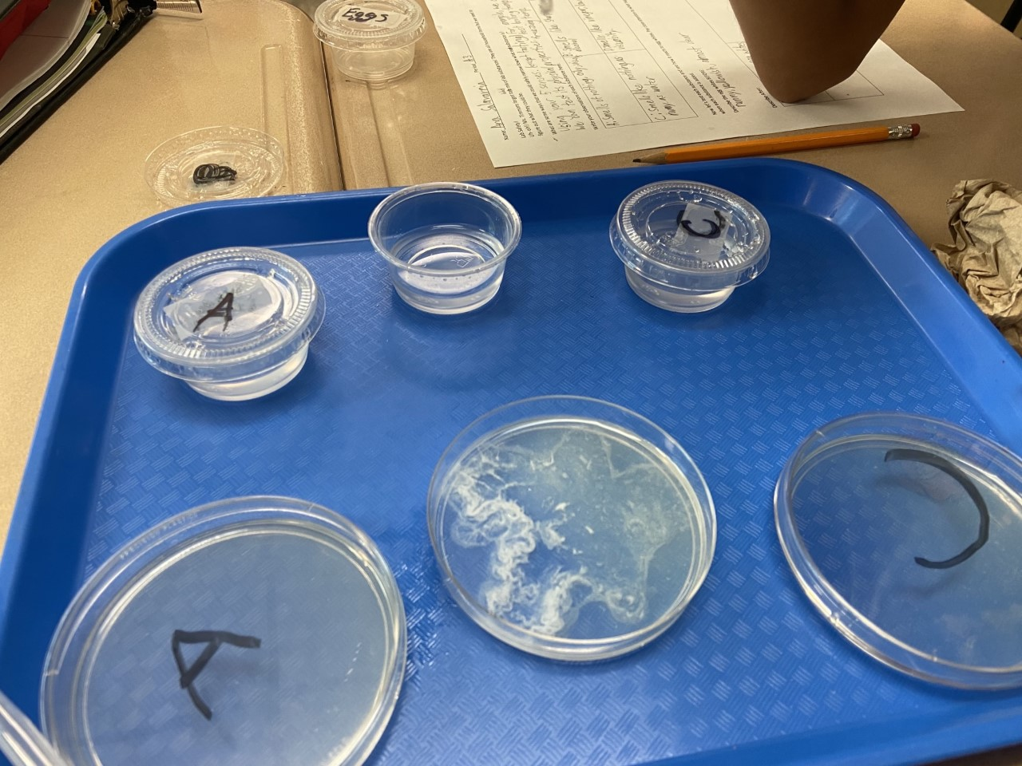
Classroom Learning
Project Based Learning
Culture of Error
Student Lead interests

Slide 5
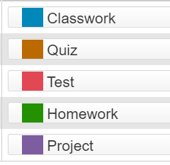
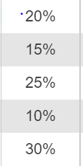
Grading Policy

Slide 6
Classroom Expectations
Respect yourself, the teacher & others
Put forth your best effort at all times
Be prepared for class each day
Follow directions when given
Pay attention, participate and ask questions
Preserve a positive learning environment
Take responsibility for your actions

Slide 7
Parent Communication
Assignments and Major Due Dates will be posted on Canvas
Email and Flyers

Slide 8
Thank you!
Contact Me
chelsea.timmons@houstonisd.org
Scan QR Code o visit
https://bit.ly/3C0g6mu

